Slide 1
Sentiment Analysis of Movie Reviews using NLP
Research/Project Presentation
by
Vedant Shreeyansh
Department of Computer Science & Engineering
Manipal Institute of Technology, Manipal
Under the supervision of
Dr. Roshan David Jathanna
Professor, Dept. of Computer Science and Engineering
Manipal Institute of Technology, Manipal
Month Date, Year

Slide 2
Presentation overview
Introduction
Literature Review
Research Gaps Identified
Objectives
Methodology
Expected Outcomes
Importance of the Proposed Research
References

Slide 3
Introduction
Correct Status
Opinion mining, another name for sentiment analysis, has grown in significance in the modern world because of its numerous uses in a variety of sectors.
Sentiment analysis provides organizations with useful information about client preferences and satisfaction in the era of social media and online review.
Statistics
Sentiment analysis has seen significant growth in recent years due to advancements in natural language processing (NLP) and the increasing availability of data. Companies across various industries are adopting sentiment analysis to understand customer opinions and sentiments.
The accuracy of sentiment analysis models has been improving steadily with the advancements in machine learning and deep learning techniques.

Slide 4
Introduction
Challenges
Sentiment is inherently subjective and context-dependent. Words and phrases can carry different sentiments based on the context in which they are used.
Sarcasm, irony, and other forms of figurative language pose significant challenges to sentiment analysis systems.
Ambiguity in language can make it difficult to determine the sentiment of a text accurately.
Sentiment analysis often relies on large volumes of text data, which can be noisy and sparse.

Slide 5
Introduction
Objectives
Analyze what customers feel about products, services, or brands.
Keep track of how people talk about a brand online to manage its reputation.
Study market trends and competitor performance through public sentiment.
Use feedback analysis to improve products and services based on customer opinions.

Slide 6
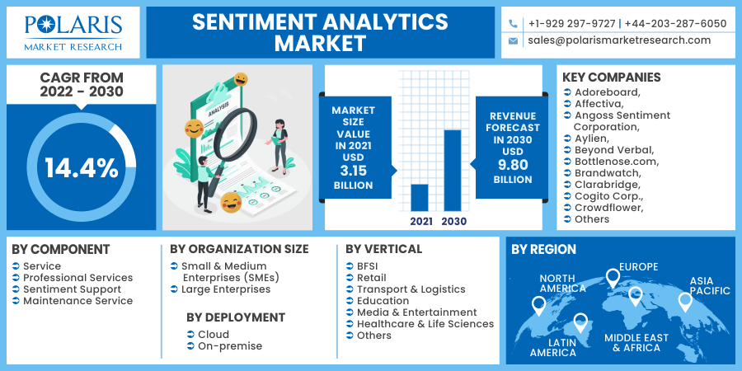
Research Topic– Significance

Slide 7
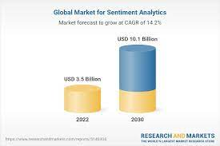
Research Topic – Global view

Slide 8
Method(s) in Research Topic
Convolutional Neural Networks (CNNs)
Machine Learning and Natural Language Processing
Python
SVM (Support Vector Machine)
SkLearn

Slide 9
Literature Review – I
Author & Year | Title | Work done | Observations
KIAN LONG TAN, CHIN POO LEE , (Senior Member, IEEE), KIAN MING LIM | A Deep Ensemble Model for Sentiment Analysis | proposes a deep learning ensemble model for sentiment analysis that combines the strengths of various neural network architectures. | Every single hybrid deep learning model applies RoBERTa to transform the input sequence into contextual word embedding. Thereafter, the sequence models are utilized to capture the long-range dependencies in the word embedding. Specifically, the sequence models are LSTM in the RoBERTa-LSTM model, BiLSTM in the RoBERTa-BiLSTM model and GRU in the RoBERTa-GRU model. The gating mechanisms of the LSTM, BiLSTM and GRU are effective in retaining the significant information even in the long input sequence, thus mitigating the vanishing gradient problem.

Slide 10
Literature Review – II
Author & Year | Title | Work done | Observations
P KATHURIA, P. SETHI AND R. NEGI | Sentiment analysis on E-commerce reviews and ratings using ML \& NLP models to understand consumer behavior | Using the ML model and NLP concepts, reviews com- parison (electronic word-of-mouth) and ratings of fashion e- commerce products to analyze sentiment has been done. | The sentiment analysis that we have done is the outcome of how positive reviews were given by different users or customers while purchasing any product It has been observed that Logistic Regression had the best results out of all ML models giving the highest accuracy for our model.

Slide 11
Literature Review – III
Author & Year | Title | Work done | Observations
T. S. N. Ayutthaya and K. Pasupa | Thai Sentiment Analysis via Bidirectional LSTM-CNN Model with Embedding Vectors and Sentic Features | Using 40 Thai children's stories, the Bi-LSTM-CNN model evaluates three distinct aspects. | The results show that combining all features-word embedding, POS embedding, and sentic features-yield the best results. This indicates that POS can enhance the model to understand semantic and role of word better and considering emotion of word can help the model to understand emotions of text.

Slide 12
Literature Review – IV
Author & Year | Title | Work done | Observations
S. A. Phand and J. A. Phand | Twitter sentiment classification using stanford NLP | The scope of the tool is to perform a sentiment analysis on a product or service. Sentiment will be classified as positive, neutral and negative there will be no in-between classes | From such a tool it is concluded that the customers or audience express their feelings in words in tweets and we can calculate the approach behind it. Sentiment analysis can be done on Twitter pages from various fields using a single tool. This involves collecting public tweets as user opinions.

Slide 13
Literature Review – V
Author & Year | Title | Work done | Observations
B. D. Shivahare, S. Ranjan, A. M. Rao, J. Balaji, D. Dattattrey and M. Arham | News text Analysis using Text Summarization and Sentiment Analysis based on NLP | Using text summarization and NLTK, this study attempts to propose a text sentiment analysis on news material | The model gives a very optimized accuracy of 91.67% which is very much efficient and reliable. This paper derives the steps and process of a proper sentiment analysis. The text data is passed into tokenization, pre-processing step and then it is handed over to NLP tool. The NLP tool analysed the scores of the text from where it can decide the actual sentiment of text

Slide 14
Research Gaps
Imbalanced datasets, where one sentiment class significantly outweighs the other, pose challenges for SVMs.
Research is needed to develop techniques within the SVM framework that effectively handle imbalanced sentiment distributions to prevent bias in model predictions.
Sentiment analysis also involves analyzing multimodal data, such as text, images, and videos.

Slide 15
Research Objectives
The aim is to construct sentiment based analysis system invariant to various constraints.
The specific goals of this research work are to
Find the maximum accuracy of the learning model.
Able to perform sentiment analysis on large text based reviews.
3) One of the primary objectives is to automatically classify and categorize textual data into different sentiment classes (positive, negative, or neutral).
4) Analyzing sentiment in customer feedback helps businesses understand customer satisfaction levels, identify areas for improvement, and make data-driven decisions.

Slide 16
Methodology
Importing the IMDB Review Dataset
Perform Text-Preprocessing using TF-IDF Vectorization
Performing Feature Extraction using SVM Classification
Generate Classification report predicting the accuracy of the model
In the last we have performed the analysis on a testing data

Slide 17
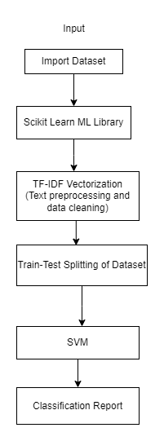
Methodology

Slide 18
Dataset (for proposed work)
The model proposed here uses IMDB Movie Reviews Dataset to perform text sentiment analysis. In the end, we have also tried to implement the model on a custom data. Although there are many available data sets to online, but IMDB is one of the most renowned sets as of now.
Sl. No. | Dataset | Details
1 | IMDB Reviews Dataset | Contains 50,000 reviews in which 25,000 has been used for training and 25,000 has been used for testing dataset

Slide 19
Expected Outcomes
The significant outcomes expected of the proposed sentiment analysis model are,
It performs the sentiment analysis on the given review dataset which are in the text format and classifies them into positive and negative reviews.
It is providing an accuracy of 87.7% which is much higher than the traditional classification methods.

Slide 20
References
Muhammet Sinan Başarslan and Fatih Kayaalp, “Sentiment analysis using a deep ensemble learning model,” Multimedia Tools and Applications, Oct. 2023, doi: https://doi.org/10.1007/s11042-023-17278-6.
“A Survey of Sentiment Analysis Based on Transfer Learning | IEEE Journals & Magazine | IEEE Xplore,” ieeexplore.ieee.org. https://ieeexplore.ieee.org/document/8746210 (accessed Feb. 15, 2024).
S. Lai, X. Hu, H. Xu, Z. Ren, and Z. Liu, “Multimodal Sentiment Analysis: A Survey.” Accessed: Feb. 15, 2024. [Online]. Available: https://arxiv.org/pdf/2305.07611.pdf
L. Bryan-Smith, J. Godsall, F. George, K. Egode, N. Dethlefs, and D. Parsons, “Real-time social media sentiment analysis for rapid impact assessment of floods,” Computers & Geosciences, vol. 178, p. 105405, Sep. 2023, doi: https://doi.org/10.1016/j.cageo.2023.105405.
Ethical Considerations in Sentiment Analysis: Navigating the Complex Landscape,” International Research Journal of Modernization in Engineering Technology and Science, Dec. 2023, doi: https://doi.org/10.56726/irjmets46811.

Slide 21
References
6) A. Mishra, A. Sahay, M. a. Pandey and S. S. Routaray, "News text Analysis using Text Summarization and Sentiment Analysis based on NLP," 2023 3rd International Conference on Smart Data Intelligence (ICSMDI), Trichy, India, 2023, pp. 28-31
7) D. K. Nugroho, "US presidential election 2020 prediction based on Twitter data using lexicon-based sentiment analysis," 2021 11th International Conference on Cloud Computing, Data Science \& Engineering (Confluence), Noida, India, 2021,
8) M. A. Shafin, Md. M. Hasan, Md. R. Alam, M. A. Mithu, A. U. Nur, and Md. O. Faruk, “Product Review Sentiment Analysis by Using NLP and Machine Learning in Bangla Language
9) Md. R. Hasan, M. Maliha, and M. Arifuzzaman, “Sentiment Analysis with NLP on Twitter Data,” 2019 International Conference on Computer, Communication, Chemical, Materials and Electronic Engineering (IC4ME2), Jul. 2019
10) P. Nandwani and R. Verma, “A review on sentiment analysis and emotion detection from text,” Social network analysis and mining

Slide 22
Thank You ☺

